Slide 1

Practical Multivariate Analysis
BIA 652
Final Project Presentation
Professor: Amir H. Gandomi
Students: Mukunth Rajendran & Raphael Presberg
Date: 04/26/2018

Slide 2
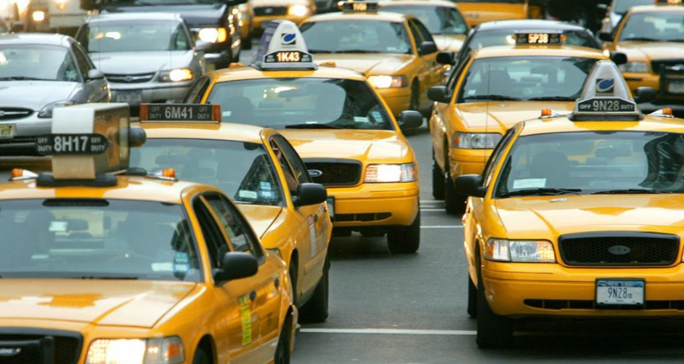

Overview
The NYC taxi says that “Please tip your driver for safety and good service” in their official site. But we don’t know how many people are willing to pay.
Tipping practices may vary among different factors depending upon the location in US. Moreover, the published guidance will vary depending upon the source.
Here we are to ask ourselves, can we predict:
how much tip the customer has to give the driver
which category does the customer belong to by taking into account the various factors involved during the travel

Slide 3
Project Summary
Data Source:
Wharton Research Data Services (WRDS) – NYC Yellow Taxi Trips – 2015
WRDS collected this public data from various sources in the public domain, the raw data is converted into a consistent format and updated on a regular basis. This dataset is organized into the content area - New York.
https://wrds-web.wharton.upenn.edu/wrds/ds/publicdata/taxis_yellow_2015.cfm?navId=321
Project objective: Here, is an analysis of predicting the tip amount that has to be paid to the driver and scaling them into 6 categories very bad customers, Ungenerous, ok, Generous, very generous and Saint with the help of various independent variables.
NYC taxi dataset didn`t contain any missing values.
Many variables were used to predict this outcome and there were great efforts involved in working with a real dataset. Removing the outliers took us a long time.
We succeeded in predicting our result using Dimension Reduction, Regression and Classification methods covered in this Multivariate Data Analysis course.

Slide 4
Data Understanding & Data Cleansing
Mukunth Rajendran & Raphael Presberg

Slide 5
Data Understanding
We chose some initial variables to perform our analysis
Our first mission is to predict how much tip should the customer give to the driver; to do so, we used those initial variables and we kept the target as ’Tip Amount’.
Then we wanted to give a prediction to the driver of the generosity of the customer. Based on the variable ‘Tip Amount’, we created a scale of generosity which will be our target.
Passenger Count
Payment Type
Vendor ID
Pre-processing
ML Algo
Target: tip Prediction
Pre-processing
ML Algo
Target: Generous or not
Total Amount
Trip Distance
Surcharge

Slide 6
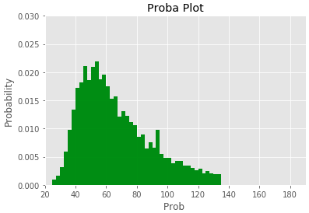
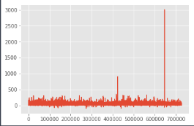
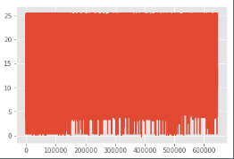
Data Processing
Probability plot after removing outliers:
Outliers impact on the variable ‘Total Amount’
 | With Outliers | Without Outliers
Mean | 15,1 | 11,5
Median | 11,15 | 10,3
Range | 3106.65 | 26
Standard Deviation | 13 | 4,8
Variance | 173 | 23
Outliers Visualization
We can see that it forms a normal distribution, having the highest probability value of .020 and X-axis ranging from 20 to 130.

Slide 7
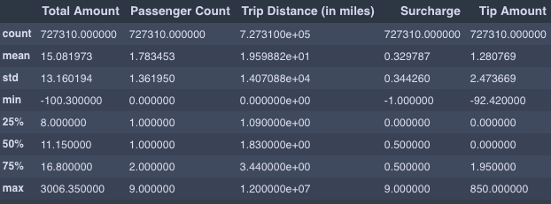
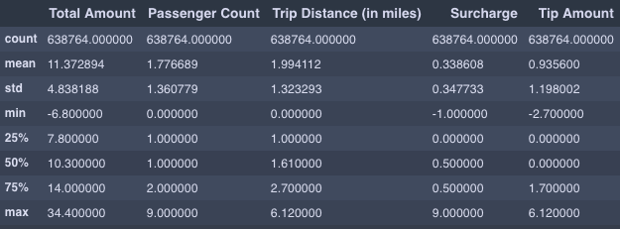
Data Processing
Outliers impact on all the dataset
From 727310 observations to 638724 ➔ around 10 % of outliers
Removing outliers significantly decreases the range, the SD and so the variance
Other mathematical properties don’t change much
WITH OUTLIERS
WITHOUT OUTLIERS

Slide 8
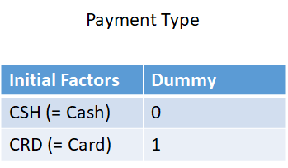
Data Processing
Dummy Variables
The Discrete variables are transformed into Dummy variables to make the analysis.
All the machine learning concepts are expected to be in numerics to make the prediction easier and faster for working on the large datasets. As dataset is large and being a real data we decided to apply dummy variables to the string variables that we used in the prediction process.
We created two columns of dummy variables using 0 and 1 as rows, stating that 0 means it doesn’t correspond to the variable and 1 means it corresponds to the variable.
Dummy variables are useful to make more accurate results.
We also worked on the Dummy variable trap and used the formula
D2 = D1 -1

Slide 9

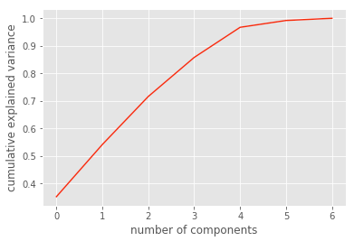
Data Processing
Principal Components Analysis
PCA is a feature extraction method, the proportion of variance is explained by the Principal components.
Comp | Variance
0 | 0.352
1 | 0.189
2 | 0.174
3 | 0.141
4 | 0.109
5 | 0.024
6 | 0.008
Principal Components (head):
Cumulative Scree plot:
By using elbow method we can see that the number of component equals 5.
The point at which the line starts to fall down is used to predict the number of component.
We can see that there are 5 components, which consist of most of the variance towards our dependent variable.

Slide 10
Machine Learning Algorithms
Mukunth Rajendran & Raphael Presberg

Slide 11
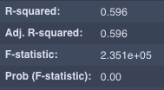
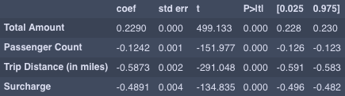
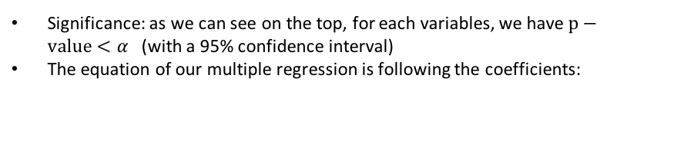
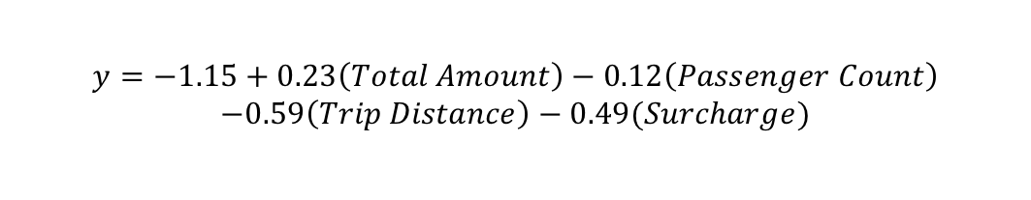
Multiple Regression
R-Squared
Equation and significance
Adjusted R-square is what is more important as it gives us an understanding of how close the data are to the fitted regression line
Before any data processing, we had a R^2 equal to 53%; now, we have R^2=60%
Significance: as we can see on the top, for each variables, we have $p−value<α$(with a 95% confidence interval)
The equation of our multiple regression is following the coefficients:
$$y=−1.15+0.23\left(Total Amount\right)−0.12\left(Passenger Count\right)$$
$$−0.59\left(Trip Distance\right)−0.49(Surcharge)$$

Slide 12
Multiple Regression
Practical
Outliers
Dummy Variables
Accuracy = 77%
Multiple Regression
Tip Amount Prediction
Prediction:
Without these two steps, our accuracy would have been 35%
For a single passenger, who will be paying by cash 15$, for a 2 miles trip, without surcharge or any special system, we are 77% confident that he will give the driver 1.64$ of tip.

Slide 13
KNN
Objective: we use the KNN algorithm to predict if the customer is going to be generous
Data Split:
Prediction:
Test Dataset
(20% of the initial dataset)
Total Amount | Pass Count | Trip Distance | Surcharge | Pymt Type | Vend ID
12 | 5 | 2 | 0 | 1 | 0
Initial
Dataset
Train dataset
(80% of the Initial dataset)
Generous
Accuracy = 98%
To calculate the accuracy of our model, we train it on the Train dataset, and then we test it on our test dataset. Furthermore, we compare the number of False Positive or True Negative with the total number of data and we obtain the accuracy percentage
Total Amount | Pass Count | Trip Distance | Surcharge | Pymt Type | Vend ID
9 | 1 | 2 | 0 | 0 | 0
Not Generous

Slide 14
KNN
Comparison with Multiple Regression
For the same problem, with the same initial dataset and data split, we built a Multiple Regression model.
The accuracy is dropping, this means that to answer whether the customer is Generous or Ungenerous, using a KNN classification algorithm gives us a better result than MR.
Accuracy = 90%
Comparison with Multiple Classes Target
We created a scale of generosity:
Categories | Meaning
0 | Very Bad Customer
1 | Not Generous
2 | OK
3 | Generous
4 | Very Generous
5 | Saint
Results
KNN accuracy: 93%
Multiple Regression Accuracy: 78%
The accuracy is dropping for both KNN & MR, this means that more complex the problem is, more difficult it is to have a high accuracy
14

Slide 15
Analysis
Meaning & Importance of the variance in a real world dataset
Discovering the significant impact of the preprocessing steps, and also we have compared the results of both before and after, we can observe a drastic change.
Understanding which model or Machine Learning technologies to use depends on the problem.

Slide 16
What is next ?
We have focus on the tip analysis for this project but there are much more to do:
Improve our current model: adding more variables to the analysis by processing all the string values, for example, the geographic information (Longitude, Latitude) or the Time&Date
Extend our needs, answer new problem: where the driver should be at any time to increase his chances of getting “good” customers, which location a customer should avoid if he wants to find a cab, etc…
Create other models, with other machine learning learning techniques, for example a Neural Network, or try to find a problem with unsupervised learning solution of using clustering.

Slide 17
Mukunth Rajendran & Raphael Presberg

